Slide 1
XML & HTML Webscraping
James R. Bradley

Slide 2
Web Scraping
Obtaining data programmatically from the Internet
… when the data owner does not explicitly provide a way for you to easily do so

Slide 3
Web Scraping
Internet data formats
XML
eXtensible Markup Language
DTD (used with XML)
Data Type Definition
JSON
Javascript Object Notation
HTML
Hypertext Markup Language
.csv, .txt, other unstructured delimited data
Idiosyncratic

Slide 4
XML
eXtensible Markup Language
Markup means
The data includes tags that annotate what each data element represents
XML was designed:
as a “general” standard that is …
customized for specific purposes…
in specific industries for…
automatically communicating data while …
assessing its completeness and validity
W3 Schools is a great resource
http://www.w3schools.com/xml/

Slide 5
XML
Intra-firm transactions
Mfg Plant
A
ERP System
Material
Usage
Info
Central
Purchasing
Central
Database
Mfg Plant
B
Required
Info for
Procurement

Slide 6
XML
Inter-firm transactions
Company 1
Company 2
ERP
Order
ERP
Invoice
Plant-Level
Computer
Systems
Plant-Level
Computer
Systems
Need way to automatically ensure that data is complete
Shop-Floor
Process
Control
Shop-Floor
Process
Control
ERP = “Enterprise Resource Planning” System

Slide 7
XML
XML structure
Hierarchy
Markup interpretation
How Data requirements are specified
Required versus optional fields
Number of fields allowed
Defining required XML structure
Document Type Definition (DTD)
Notes:
Information content is in bold.

Slide 8
XML
Sample hierarchical data structure
Root Element
Element: COURSE_SCHEDULE
…
Element: COURSE
…
Element:
COURSE_NUMBER
Element:
COURSE_NAME
Element:
SESSION
Element:
SESSION
Element:
SESSION_NUMBER
Element:
SESSION_TIME
Element:
DAY
Element:
SESSION_NUMBER
Element:
SESSION_TIME
Element:
DAY
1 Element required
At least 1 Element but possibly more

Slide 9
XML
XML Markup
Start tag: <tag_name>
End tag: </tag_name>
Sample data element: <Course_Name>CTBA</Course_Name>
Data hierarchy
<Course_Schedule>
<Course>
<Course_Number>BUAD 5012</Course_Number>
<Course_Name>CTBA</Course_Name>
<Session>1</Session>
<Session>2</Session>
<Session>3</Session>
</Course>
</Course_Schedule>
Session is a ‘child’ field of the ‘parent’ Course field

Slide 10
XML
XML Markup
Tags apply to everything between the starting and ending tag
Some are (child) tags
Some tags contain data:
<SESSION_NUMBER>1</SESSION_NUMBER>
Some tags such as Course_Schedule contain other tags, but no data:
<Course_Schedule>
<Course_Number>BUAD 5012</Course_Number>
<Course_Name>CTBA</Course_Name>
</Course_Schedule>

Slide 11
XML
XML is well formed if no syntax violations, which is mostly about correct use of beginning and ending tags
Every beginning tag has an associated ending tag
Tags are nested correctly, hierarchically
Every “tag section” must be fully contained within its parent tags
Correct Nesting
<tag1>
<tag2>
</tag2>
</tag1>
Incorrect Nesting
<tag1>
<tag2>
</tag1>
</tag2>

Slide 12
XML
Invalid XML—missing ending tag
<Course_Schedule>CTBA
<Session>1
<Session>2</Session>
<Session>3</Session>
</Course_Schedule>
Invalid XML—missing ending tag
<Course_Schedule>
<Session>1</Session>
<Session>2</Session>
<Session>3</Session>

Slide 13
XML
More details about syntax rules and well formed according to XML 1.0 specification:
Reference: https://en.wikipedia.org/wiki/Well-formed_document
Content delimited with a beginning and end tag
Content properly nested (parents within roots, children within parents)
Syntax rules satisfied (e.g., characters excluded from tag names)

Slide 14
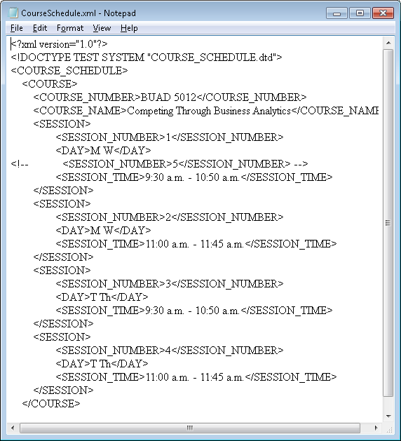
XML

Slide 15
XML
XML also provides for a way to check if all the data that is expected is contained in a transmitted XML document
Requires second, Document Type Definition (DTD), document
XML satisfying DTD requirements is valid
Being well formed is always required
Being valid is not always an issue
There may not be a DTD
This lecture ignores DTDs and validating XML documents with them

Slide 16

XML
Designates XML
language and version
Reference to DTD
Lines starting with <!– and ending with -->
indicate comments

Slide 17
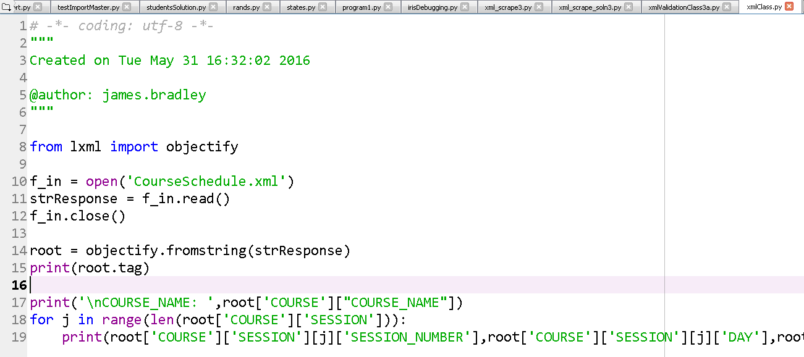
XML
Extract data from XML file
Loop through multiple elements (SESSION)

Slide 18
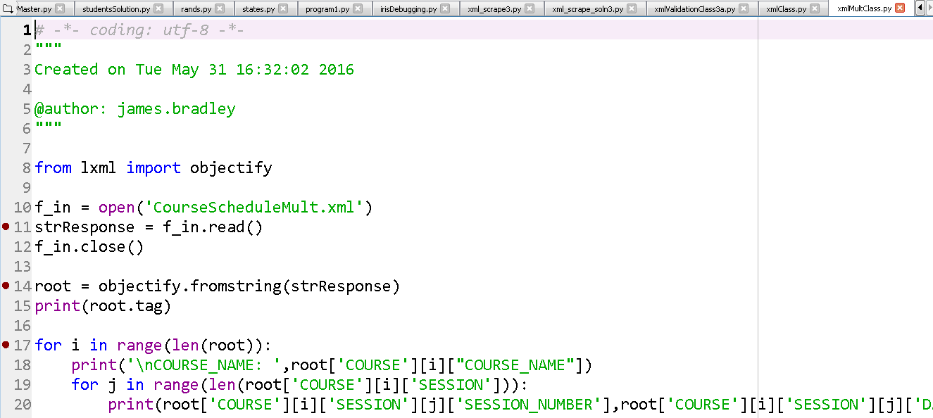
XML
Extract XML data for multiple classes

Slide 19
Web Scraping Recommendation
Google Chrome is the required browser for web scraping
It has the best resources for web scraping

Slide 20
XML
Example: Weather feed from NOAA
http://w1.weather.gov/xml/current_obs/seek.php?state=va&Find=Find
For Williamsburg, RSS and XML:
http://w1.weather.gov/xml/current_obs/KJGG.rss
http://w1.weather.gov/xml/current_obs/KJGG.xml
Source is XML
Use Right-click, Inspect in Google Chrome, or
Right-click, View Page Source
For Williamsburg, last 3 days details HTML
http://w1.weather.gov/data/obhistory/KJGG.html

Slide 21
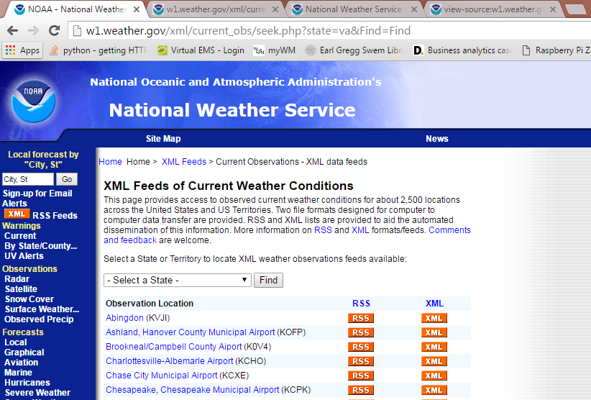
XML
Example: NOAA
http://w1.weather.gov/xml/current_obs/seek.php?state=va&Find=Find

Slide 22
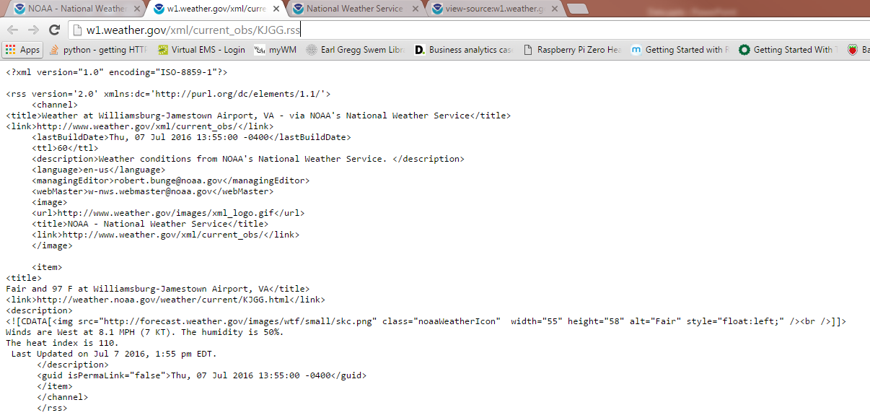
XML
Example: NOAA RSS feed

Slide 23
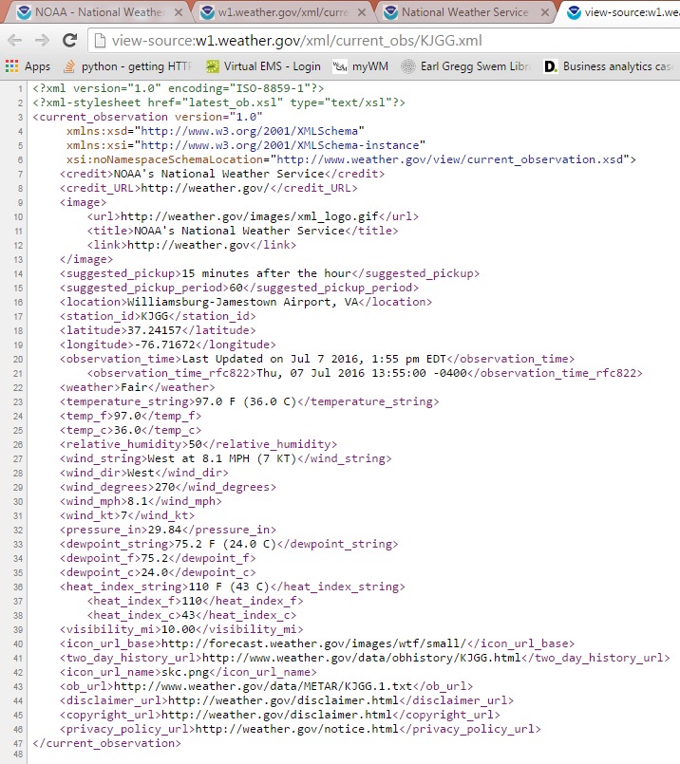
XML
Example: NOAA
View Source of XML link

Slide 24
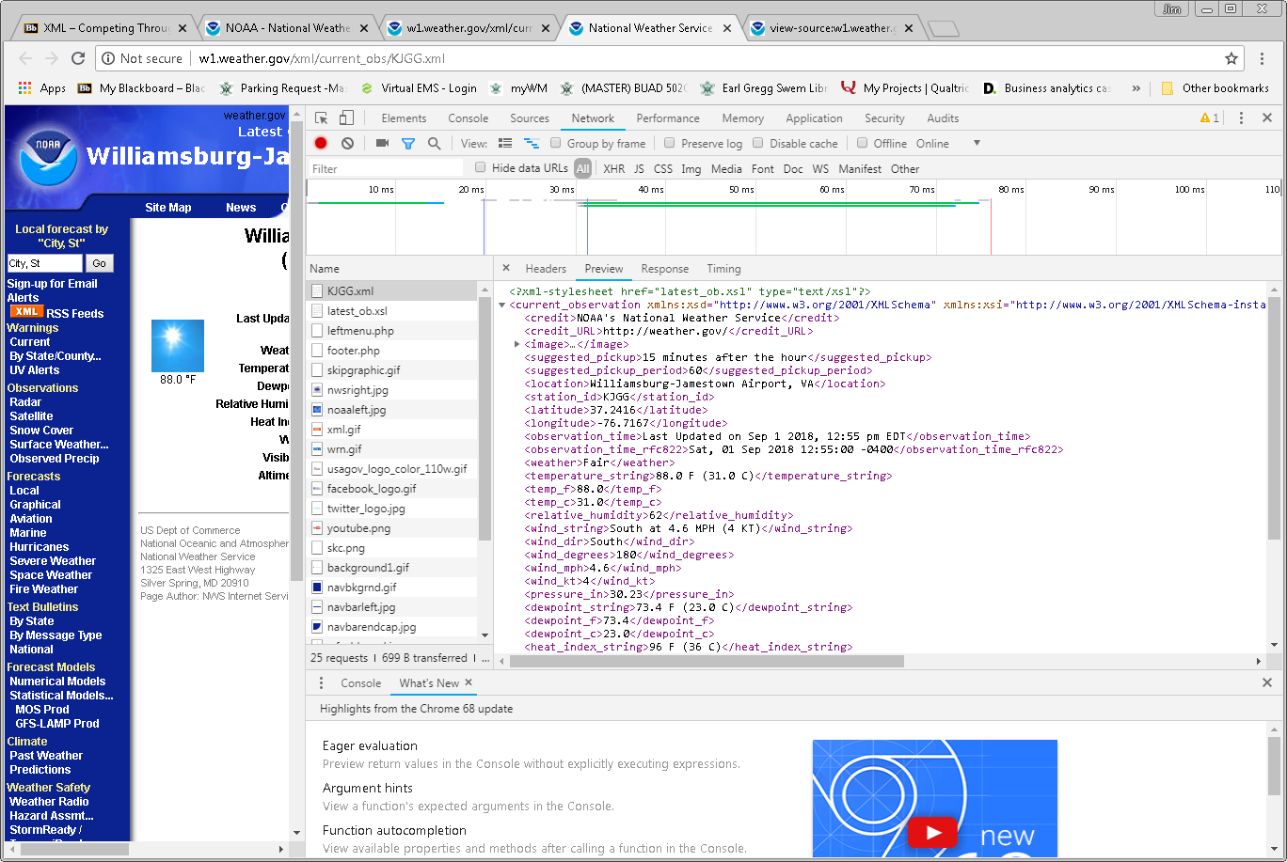
XML
NOAA: Right-click, Inspect

Slide 25
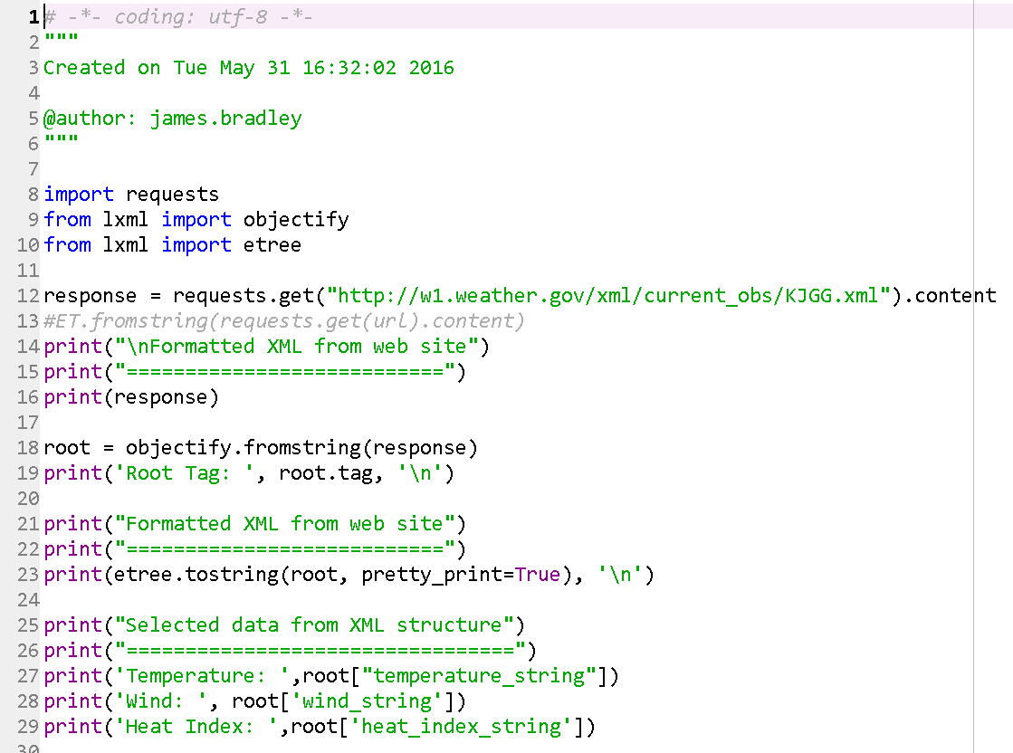
XML
Scrape NOAA XML data: noaaRSS3.py
Python packages
requests package gets Internet data
lxml package parses XML documents

Slide 26
XML
Change the code in noaaRSS3.py to print out these data also:
Latitude
Longitude
The url tag data within the title tags
Data with these tags:
icon_url_base
icon_url_name
Rename your revised program

Slide 27
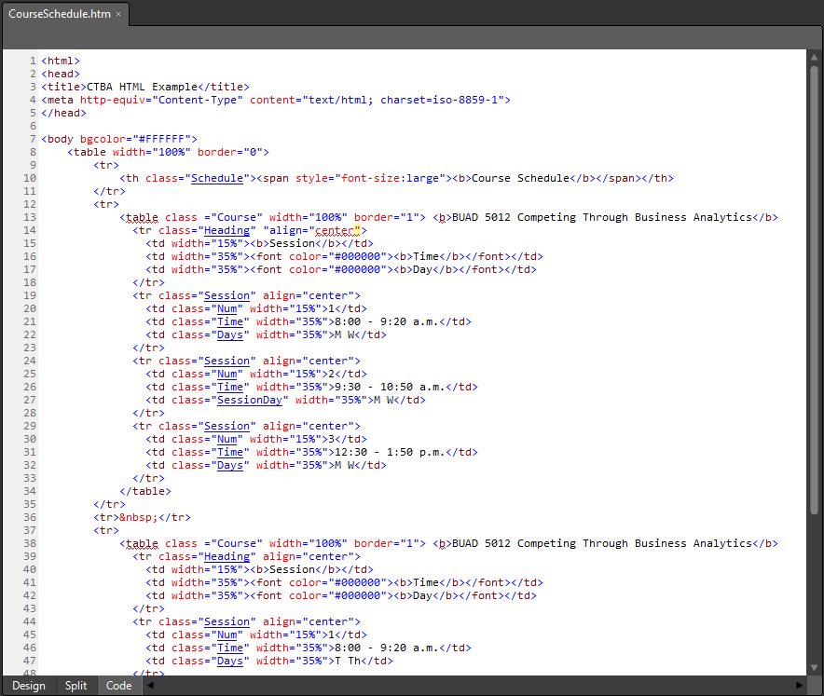
HTML
HTML is similar to XML:
Has a hierarchy
Specifies data/structure using markup: Tags
Example Tags:
body = content
tr = table row
td = cell in table row
b = bold
table = table

Slide 28
HTML
HTML is different than XML
Tags are about formatting, not content
Data structure is not regular
Many different structures within a document
Often not well-formed
Browsers will still render ill-formed HTML
Attributes and attribute values
Attributes and specific values are often coincident with the data of interest
More difficult than XML data to search

Slide 29
HTML
In CourseSchedule.htm the attributes/values:
Reflect structure
Facilitate scraping
Attribute Value
Attribute Name

Slide 30
HTML
Scraping HTML is similar to scraping XML but you might use a different Python package
E.g., BeautifulSoup
HTML idiosyncrasies
HTML data structure not always consistent, valid
But, you can use attributes to identify target data
HTML differs from XML in that:
Includes formatting data
XML can use ancillary XSLT formatting document
Includes attribute tags
Never checked against DTD

Slide 31
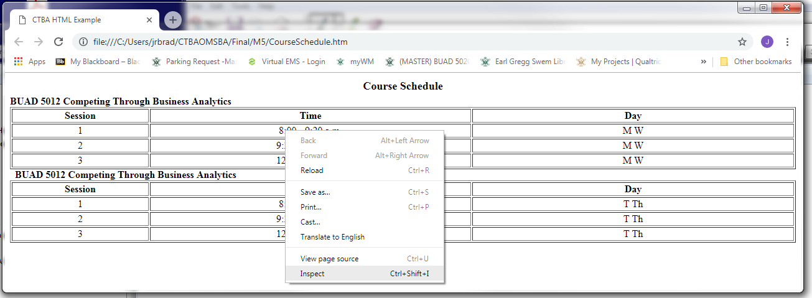
HTML
You need to spend time discovering
Where your target data is,
Structure of the web page, and thus
How to search for it
Open CourseScheduleWClues.htm w/Chrome
Right click on web page element and choose Inspect

Slide 32
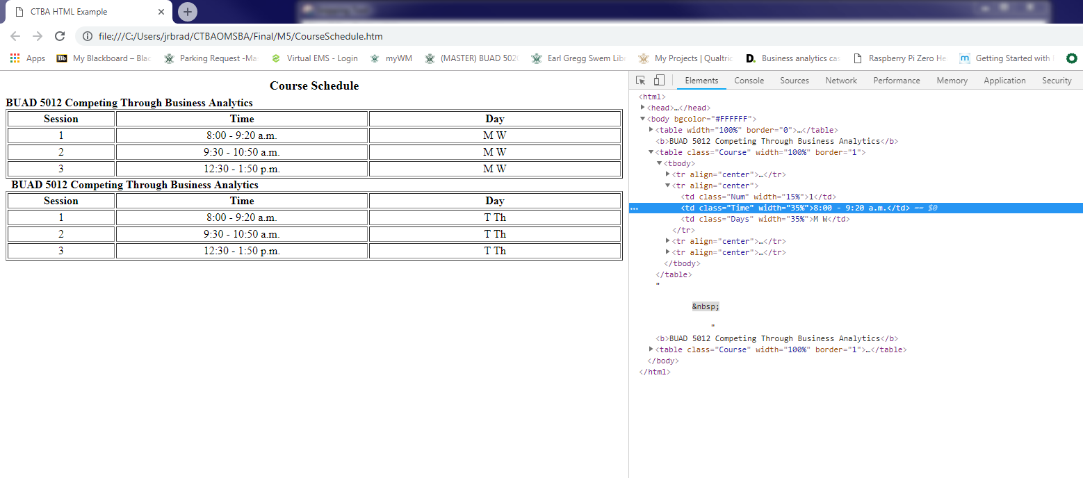
HTML
HTML code

Slide 33
HTML
Explore structure and find ways to locate your target data uniquely
Explore tag attributes and values
Use Ctrl+F to determine uniqueness of an attribute or attribute value
If the tag and/or the tag-attribute pair are uniquely associated with the target data, then you are done
If not then you need to find a parent tag that is unique and then drill down.

Slide 34
HTML
Unique attribute name & value

Slide 35
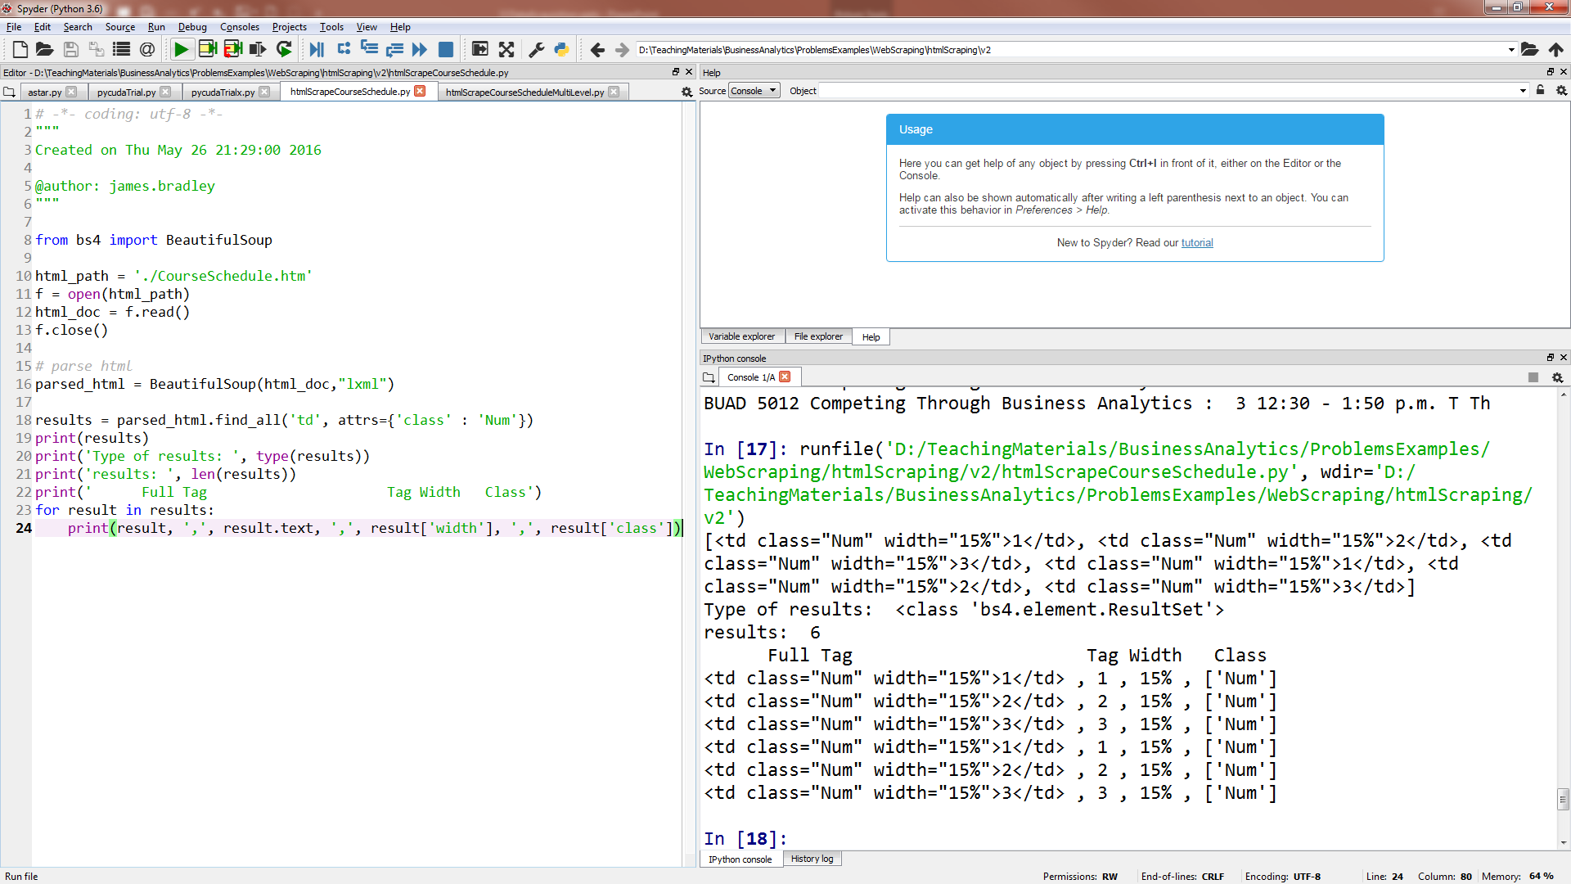
HTML
Scraping CourseSchedule.htm

Slide 36
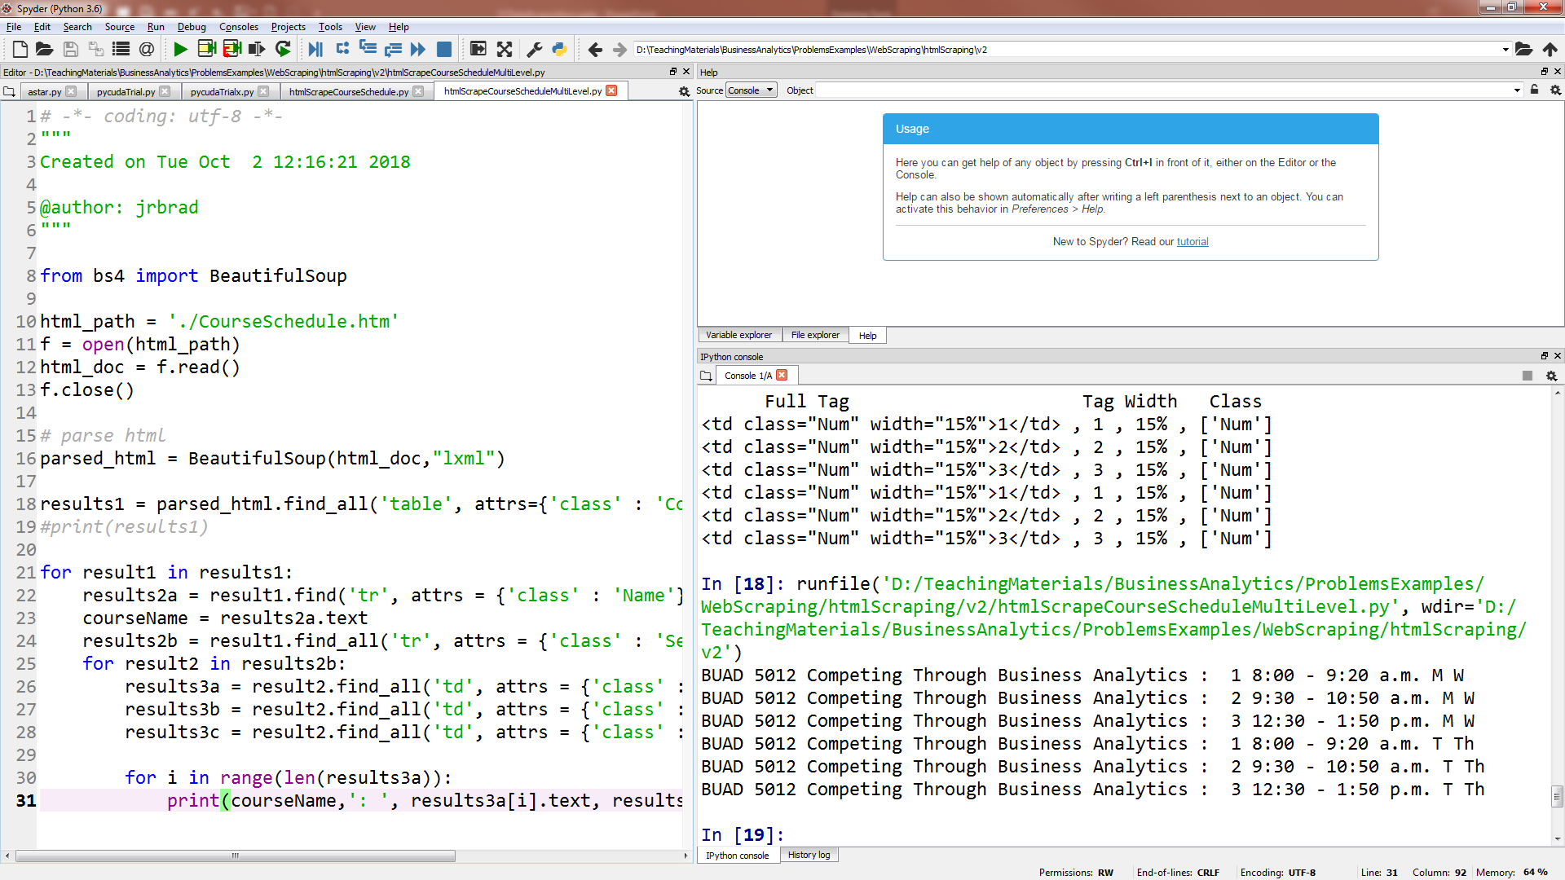
HTML
Multi-level search

Slide 37
HTML
Multi-level search
Search for ‘class’ : ‘Course’
Then, search for ‘class’ : ‘Session’
Then search for each of these within sessions:
‘class’ : ‘Num’
‘class’ : ‘Time’
‘class’ : ‘Days’
HTML is usually not this well annotated with tags

Slide 38
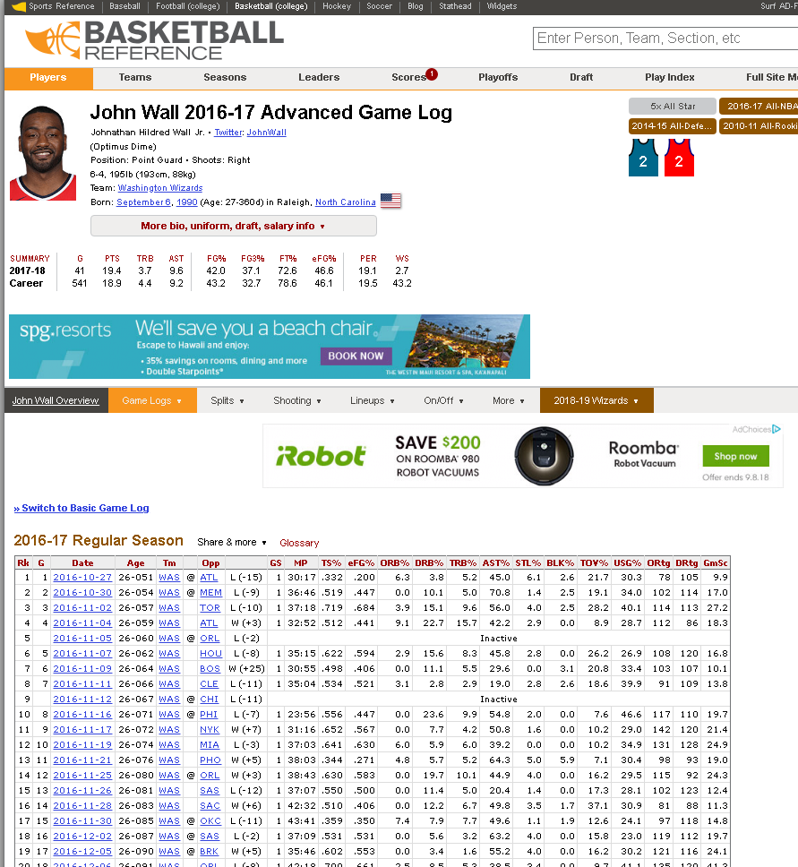
HTML
https://www.basketball-reference.com/players/w/walljo01/gamelog-advanced/2017/
Notes:
Keep attribute: class
Key value: starts with “pgl_advanced.”

Slide 39
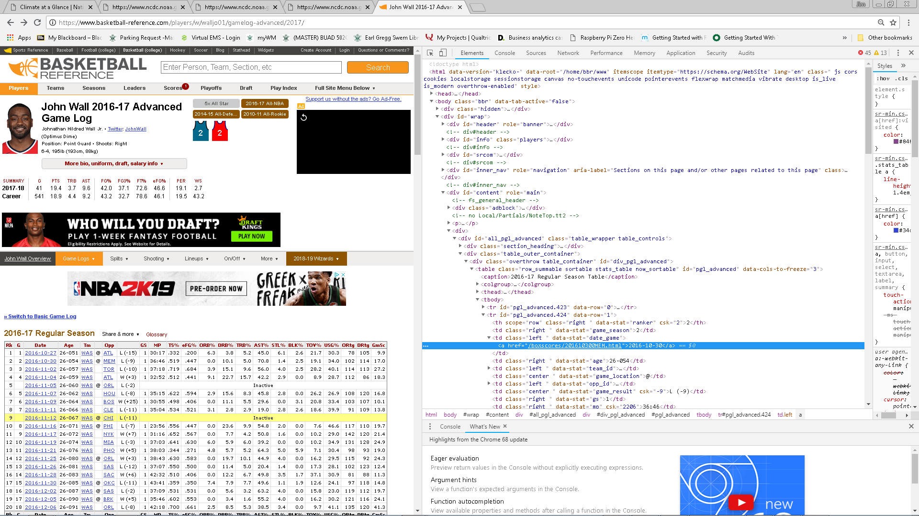
HTML
Right-click, Inspect for HTML structure

Slide 40
HTML
Scraping John Walls NBA data
https://www.basketball-reference.com/players/w/walljo01/gamelog-advanced/2017/
html_scraping_bsoup_V3.py
Uses
BeautifulSoup.py package
.find_all()
Finds all next occurrences
You might also be interested in .find() method
Finds the next occurrence
Regular expressions to find particular HTML tags that we identified manually

Slide 41
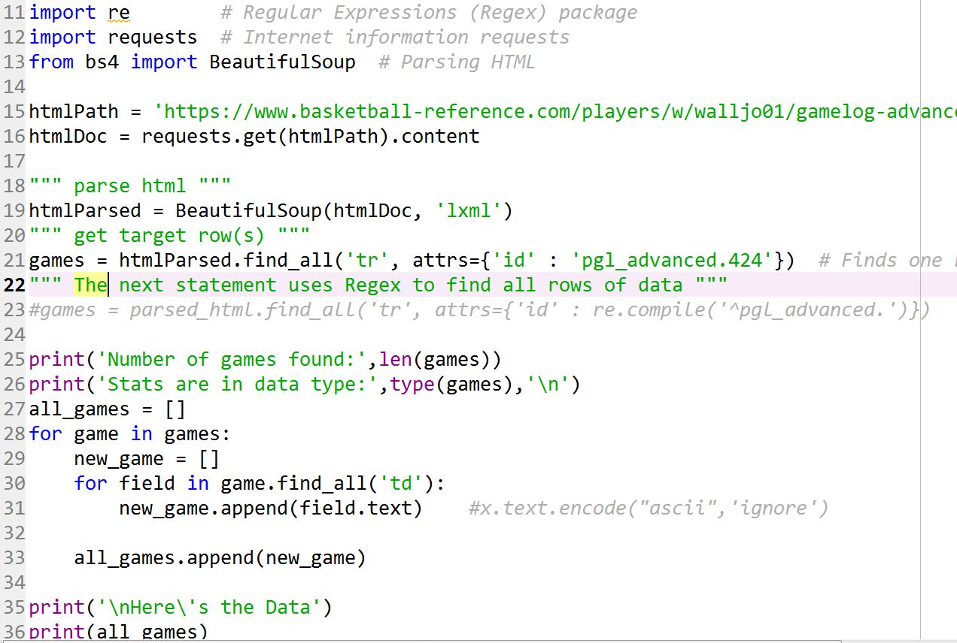
HTML
0
1
2

Slide 42
HTML
Use BeautifulSoup to parse initial HTML retrieved (Step 0)
Find table rows, tr tag, with attribute pgl_advanced using Regex (Step 1)
target_rows is a BeautifulSoup ResultSet type
ResultSet is a list of BeautifulSoup Tag types
.find_all to find rows with td tag within the rows that were found (Step 2)
You can search tags from ResultSet using .find_all

Slide 43
HTML Webscraping Resources
W3 Schools is a great resource!
http://www.w3schools.com/html/
… for iterative diving deeper in HTML hierarchy
https://stackoverflow.com/questions/10309550/python-beautifulsoup-iterate-over-table
https://stackoverflow.com/questions/25212261/python-beautifulsoup-iterating-over-a-table
https://stackoverflow.com/questions/26646231/beautiful-soup-parsing-span-element
Includes span tags

Slide 44
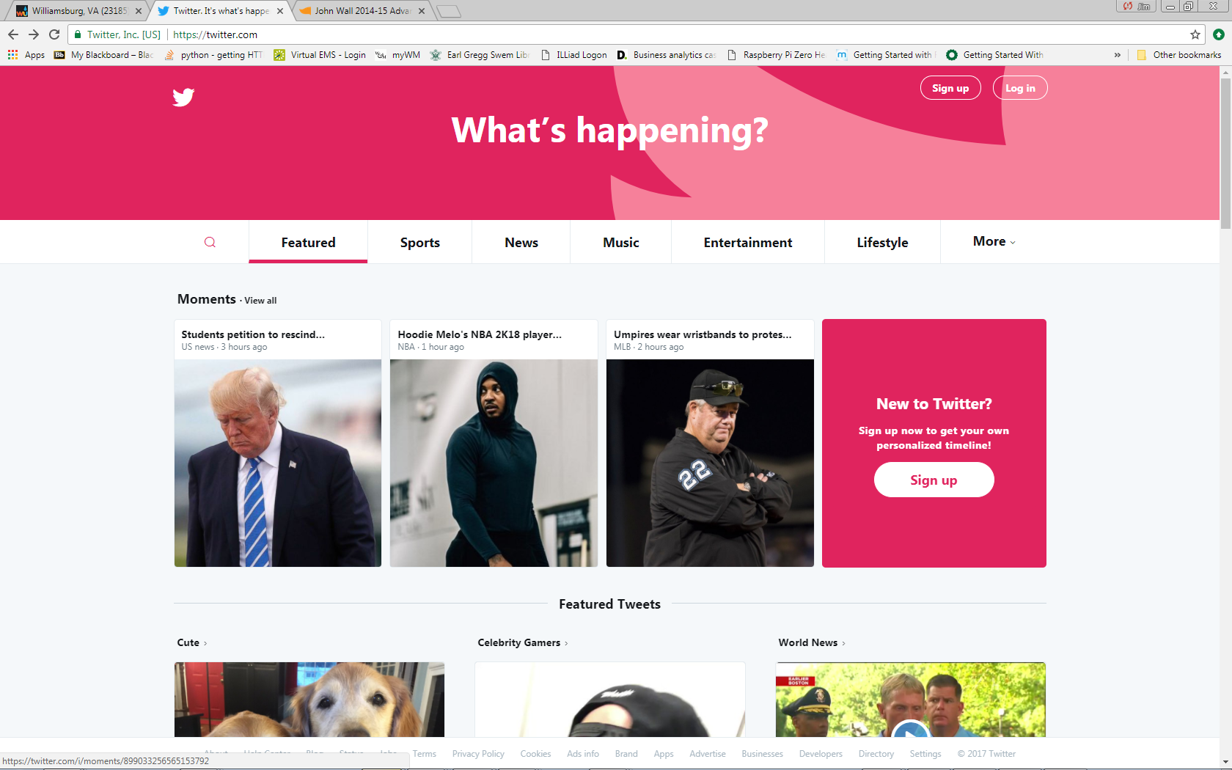
HTML
Class Exercise: twitter.com
Scrape information for each Moments:

Slide 45
HTML
Class Exercise: twitter.com
Scrape items shown below for each Moment, plus:
The data-moment-id value
We’ll need to talk about this a little
Full text of caption
Category

Slide 46
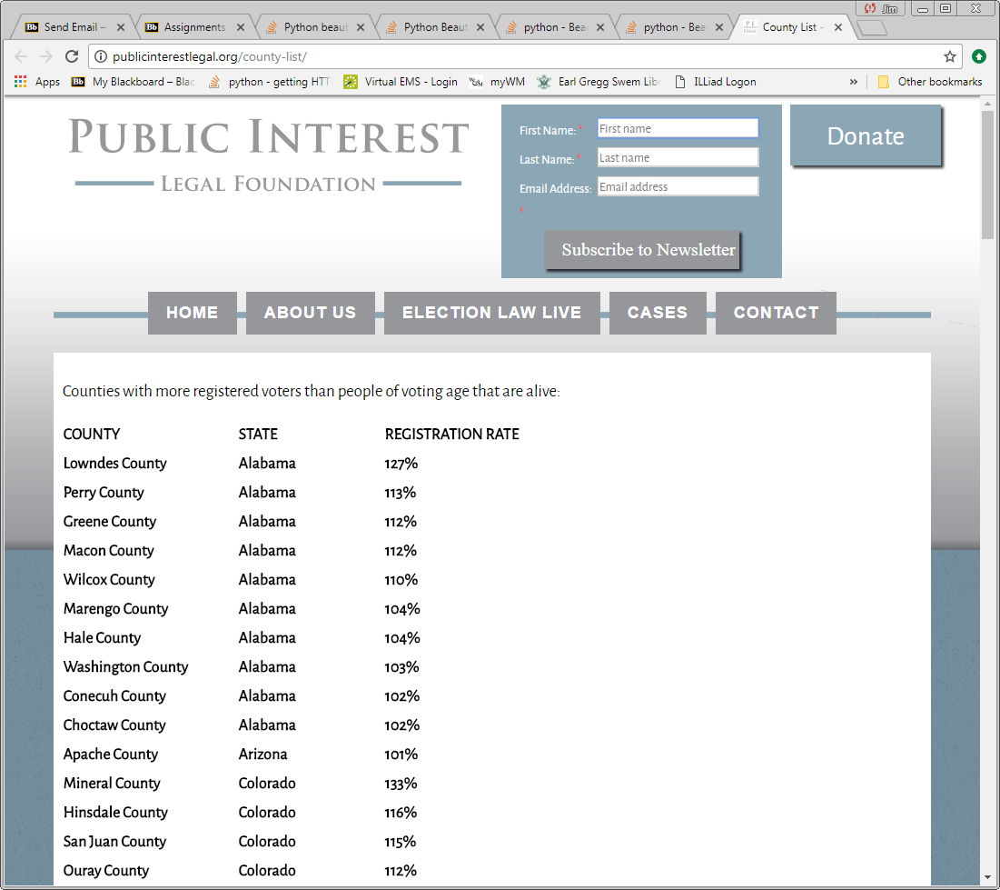
HTML Assignment
Scrape voting data from http://publicinterestlegal.org/county-list/

Slide 47
Scraping: Emerging Industry?
Many companies do web scraping services:
https://www.promptcloud.com/
https://www.scrapehero.com/
http://webdata-scraping.com/
http://scrapinghub.com/
https://www.grepsr.com/
http://80legs.com/
https://webrobots.io/
http://datahut.co/
http://webscraper.io/
Software
https://www.import.io/

Slide 48
Scraping: Emerging Industry?
This and other companies may be relying on web scraping technology for their services:
http://www.evolve24.com

Slide 49
Webscraping
Some of the MSBA graduates used scraping in their jobs almost immediately…
Their employers were impressed

Slide 50
Summary Comments
You must understand HTML, XML, JSON data formats
Some of you will find web scraping very helpful

Slide 51
Summary Comments
Web sites pass data in a variety of manners
Data can be in the web page HTML or from server API
API data format varies
JSON format can vary
Could be XML
Could be something else
…need to first figure out the formatting
Web page data delivery can vary over time:
E.g., NBA data no longer served up by API
http://www.basketball-reference.com/players/w/walljo01/gamelog/2015/

Slide 52
Ethical Webscraping
One view:
https://www.summet.com/dmsi/html/readingTheWeb.html
My Airbnb project
Request header change
robots.txt
This file in root directory of most web sites
Describes where you may scrape

Slide 53
Ethical Webscraping
Some companies will cut you off even if you abide by the robots.txt file
Amazon.com monitors it’s traffic and will cut you off

